Slide 1
Mobile Technologies from the past, present and future
Benas Mikalauskas

Slide 2
Quick look at all the IOS/OS
Our focus is going to be around the development of Android IOS, but there are four more IOS/OS available in the market today:
Apple IOS
Windows IOS
BlackBerry OS
Symbian OS
So lets start from them.

Slide 3
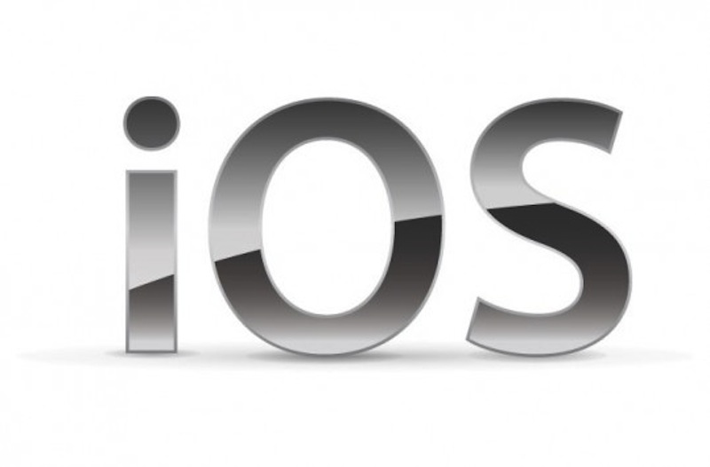
Apple iOS
Apple iOS was released by Apple in 2007 as the new operating system for there iPhones. What iPhone did differently they also adjusted the iOS to work on other devices such as media player iPod and in 2010 they added it to iPads as well. The iOS takes a second place in most used IOS, mainly because iOS is only used on Apple products while for instance Android can be found in many different smartphones and tablets.

Slide 4
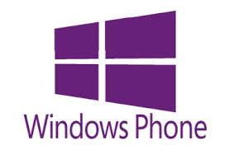
Windows IOS
Windows IOS started of with Windows Mobile. In 2010 Windows Mobile was discontinued and instead it was rebuilt and renamed to Windows Phone. The Windows IOS take up the 3rd position in the smartphone races as it only has a small share of smartphones running their IOS whit one of the bigger ones being Nokia whom they bought out in 2014. The first Windows IOS version was 7 as the IOS fallow the trend of there computer OS in name and design.

Slide 5

BlackBerry OS
BlackBerry is a dying OS, that was very popular and capable at its time, but Android and Apple iOS has overpowered it, as of 2013 BlackBerry has discontinued their OS, but still support it.

Slide 6

Symbian OS
Symbian OS was the main operating system before Android launched. It was supported by most of the major phone companies. But when Android launched it started it overtook all of the phone companies. Nokia was the last ones to use Symbian OS until Microsoft bought them out in 2010.

Slide 7
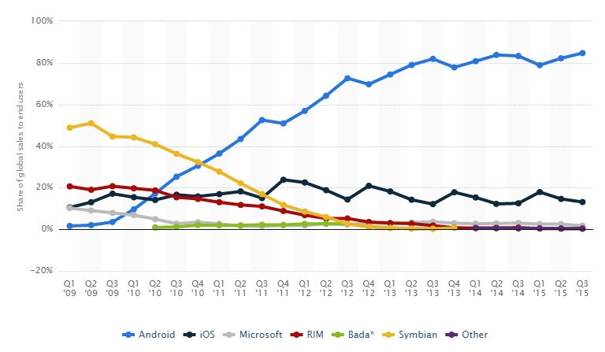
Smartphone OS market share 2009-2013
These are the numbers of market sharing from the last 8 years. As we can see Symbian was the dominant force before the Android launched, after that it slowly declined as Android rose to the very top. Apple kept its number steady. From the chart we can see that while Apple maintained there regular number of clients, Android took all of the Blackberry, Microsoft and Symbian ones.

Slide 8

Android 1.5 Cupcake
Android 1.5 Cupcake was the first version to be released in 2008. It instantly got popular and started to change the market of phone OS.

Slide 9

Android 1.6 Donut
Android 1.6 Donut implemented new changes to OS with improvements of web searching and video watching online.

Slide 10
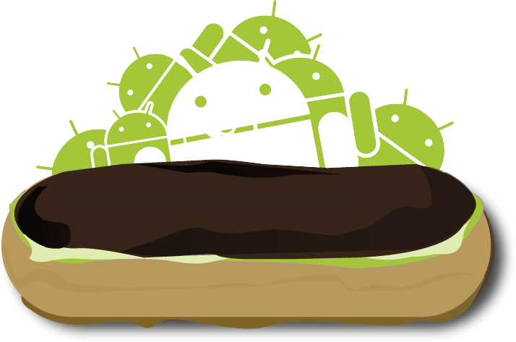
Android 2.0 Eclair
Android 2.0 Éclair introduced home screen customisation. Apps and widgets were allowed to be moved and arrange in different ways.

Slide 11
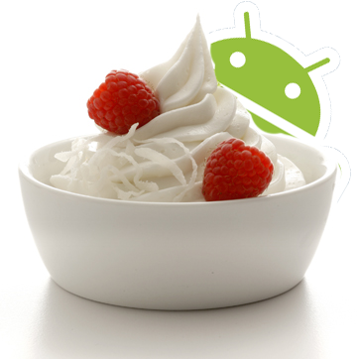
Android 2.2 Froyo
Android 2.2 Froyo added the option to use voice for writing messages, this led to future features like “OK Google”.

Slide 12
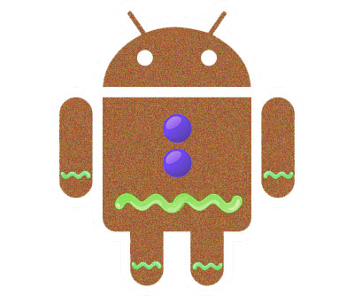
Android 2.3 Gingerbread
Android 2.3 Gingerbread added the function to use sensors which allowed apps to using functions such as tilting.

Slide 13

Android 3.0 Honeycomb
Android 3.0 Honeycomb was made to support tablets as well. This was done because of the table rise in the market.

Slide 14

Android 4.0 Ice Cream Sandwich
Android 4.0 Ice Cream Sandwich changed the overall design of the OS, it also added 1080p-HD camera support and editor for pictures. The main reason would be the rise of social media with websites such as Instagram and Tumblr.

Slide 15

Android 4.4 KitKat
Android 4.4 KitKat improved the design and performance. It also added the “OK Google” which lets user give out voice commands to their phones.

Slide 16
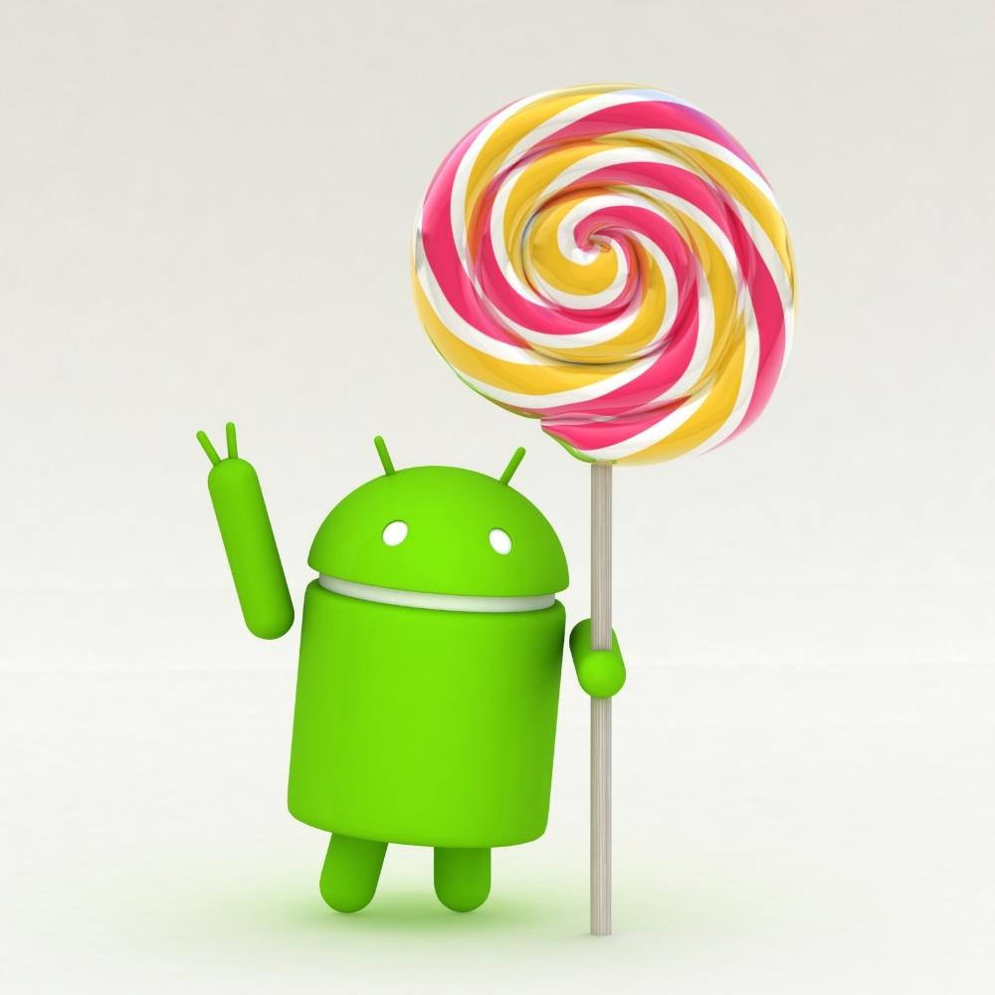
Android 5.0 Lollipop
Android 5.0 Lollipop added a bigger screen support, so it would be compatible with smart TVs.

Slide 17
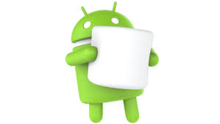
Android 6.0 Marshmallow
Android 6.0 Marshmallow adds 4K display mode for apps, “Google Now Tap” function to do google searches of what is based on he screen atm.

Slide 18
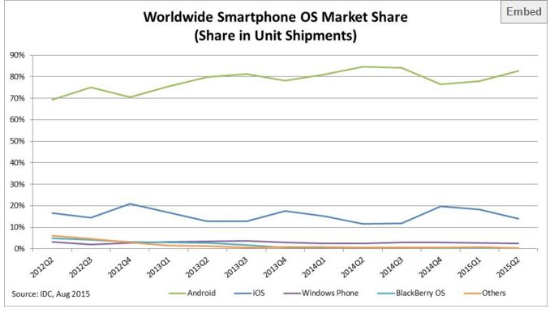
Current market share
At the moment market is dominated by Android since they have the most supported devices in it. Second is Apple whit their steady flow of clients.

Slide 19
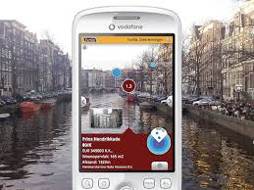
What awaits in the future? 1/2
Augmented Reality – it is predicted and expected that in the near future we will have a feature in our phones that when pointing the camera at something we will be displayed instant information about the things it sees.

Slide 20
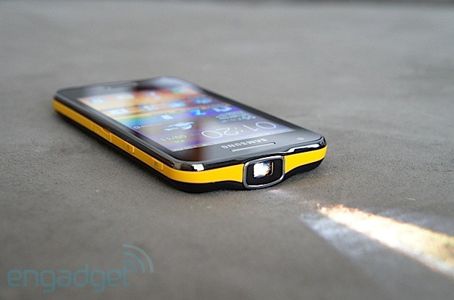
What awaits in the future? 2/3
In Built projectors to make the smartphones more flexible and in some casing for playing video games even used instead of TVs.

Slide 21
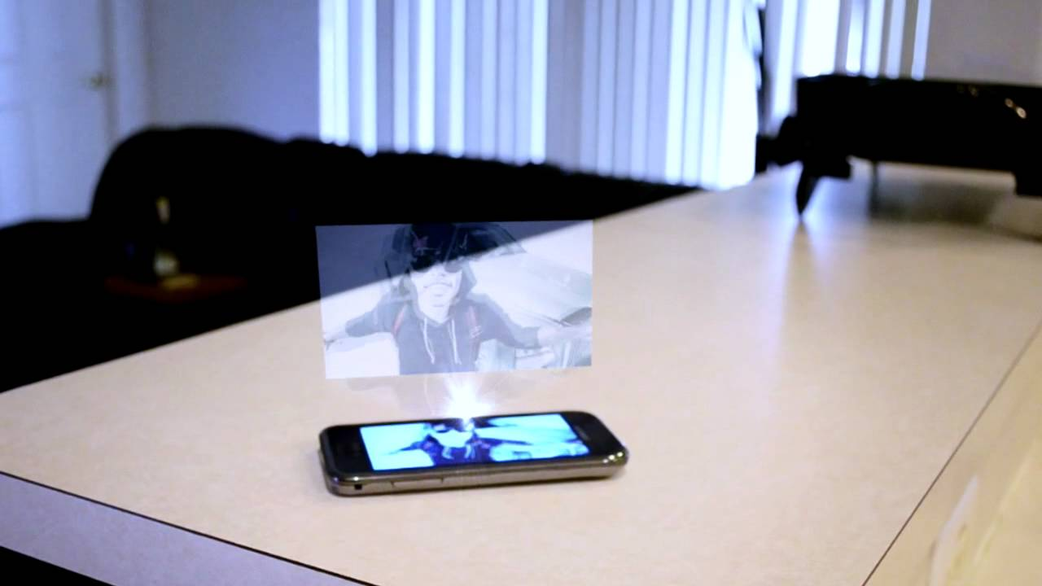
What awaits in the future? 3/3
3D screens and holograms because just 3d is not enough nad having a hologram image sticking out of your phone would be a complete sci-fi brought to life experience.

Slide 22
References
http://www.hongkiat.com/blog/future-smartphone-features/
https://en.wikipedia.org/wiki/Android_version_history
http://www.idc.com/prodserv/smartphone-os-market-share.jsp
http://www.statista.com/statistics/266136/global-market-share-held-by-smartphone-operating-systems/

